Slide 1
Basic presentation

Slide 2
agenda
Introduction
Data Exploration
Feature Engineering
Model Selection
Performance Evaluation

Slide 3
Introduction

Slide 4
In this project, we will analyze how various lifestyle factors such as physical activity, stress levels, and BMI categories impact sleep. This project will provide insights into how different lifestyle choices affect sleep health and overall well-being.
Insomnia: Difficulty falling asleep or staying asleep despite the opportunity to sleep. It can be short-term or long-term and may be caused by various factors like stress or poor sleep habits.
Sleep Apnea: Pauses in breathing during sleep, leading to shallow breaths or complete stops in airflow. There are two main types: obstructive (due to throat muscle relaxation) and central (due to brain signal issues). It can cause symptoms like loud snoring and daytime fatigue and may lead to serious health issues if untreated. Treatment options include lifestyle changes, CPAP therapy, oral appliances, or surgery.

Slide 5
Features description
Person ID: The IDs are uniformly distributed between 1 and 374.
Age: The average age is approximately 42 years, with a range from 27 to 59 years.
Sleep Duration: The average sleep duration is about 7.13 hours, with most values between 5.8 and 8.5 hours.
Quality of Sleep: The average quality of sleep score is 7.31, with a range from 4 to 9.
Physical Activity Level: The average physical activity level is 59.17, ranging from 30 to 90.
Stress Level: The average stress level is 5.39, with most values between 3 and 8.
Heart Rate: The average heart rate is 70.17 beats per minute, with a narrow range from 65 to 86.
Daily Steps: The average number of daily steps is 6816.84, with most values between 3000 and 10000 steps.

Slide 6
Data Exploration

Slide 7
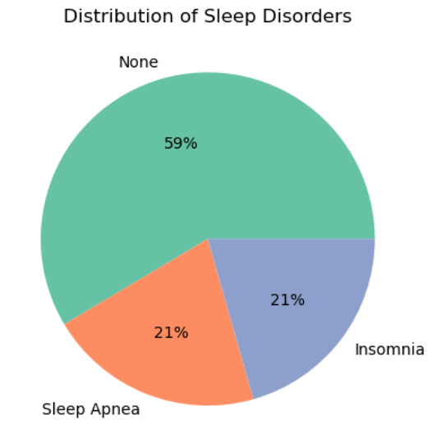
The distribution of insomnia and sleep apnea is equal.

Slide 8
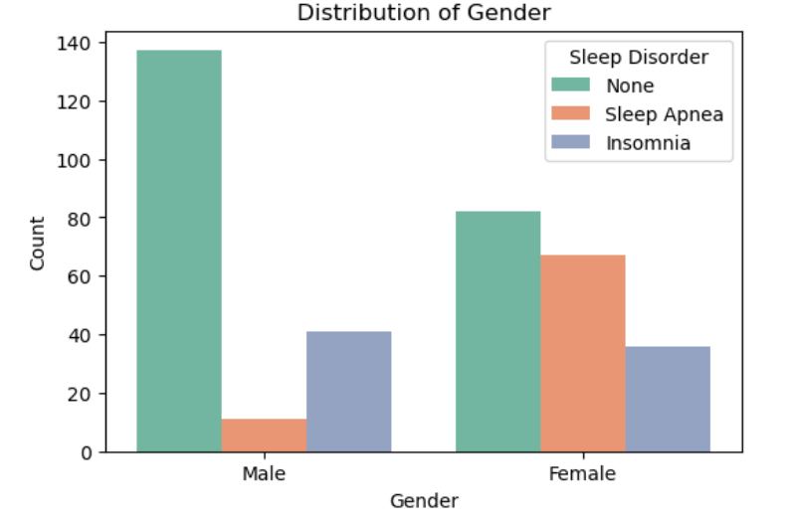
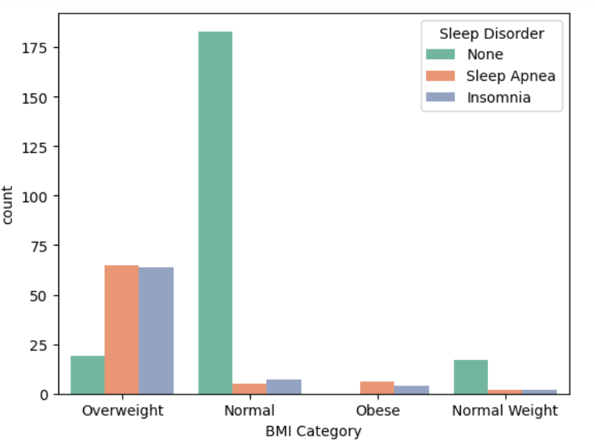
The Gender variable is well balanced. It can be observed that females tend to have higher cases of sleep disorders than males.
All obese people have either sleep apnea or insomnia, most of the overweight people have a sleep disorder, and very few people with normal BMI have sleep disorders.

Slide 9
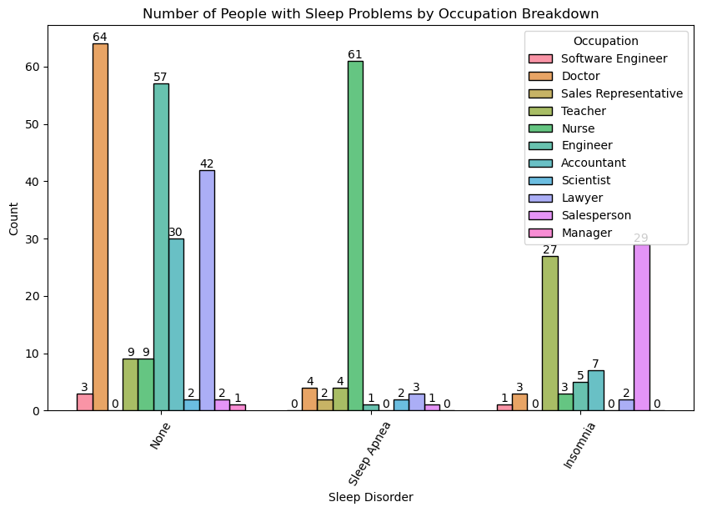
1. Among normal individuals, doctors are in the majority.
2. In sleep apnea, nurses the majority among individuals.
3. In insomnia, salesperson and teachers take the lead among individuals.

Slide 10
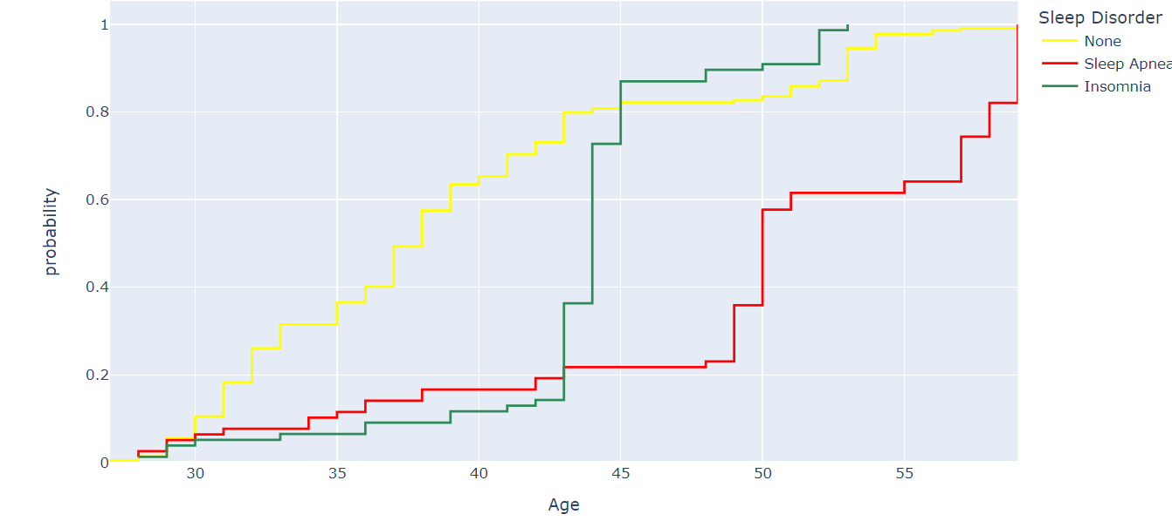
Insomnia is not common in people aged 55 and over.
People with sleep apnea tend to be older, with the majority being over 45 years old.
The likelihood of sleep disorder shows a sudden significant increase, especially between the ages of 40-45, and it makes a large jump above 50% in the 45-50 range.

Slide 11
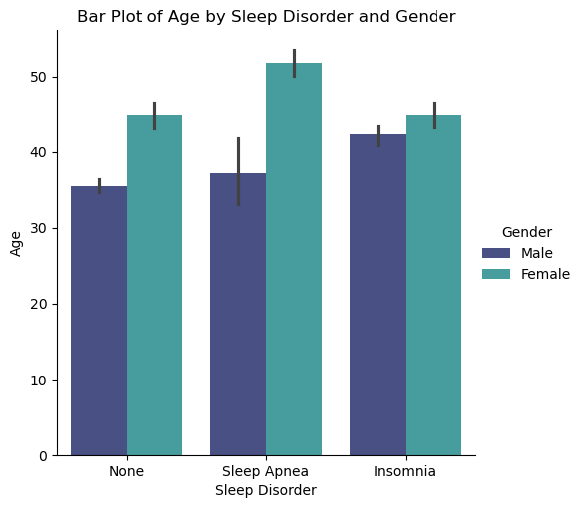
Insomnia: The age distribution for insomnia peaks around 30 and 50 years old, suggesting it may be more common in both younger and older adults.
None: Individuals without sleep disorders show a relatively even distribution across all ages, indicating that sleep disorders are not limited to any particular age group.
Sleep apnea: The age distribution for individuals with sleep apnea is skewed towards older adults, with a peak around 60 years old, implying it may be more prevalent in this age group.
Age distribution by gender:
Female: The age distribution for females is relatively evenly distributed across all ages.
Male: The age distribution for males is skewed towards older adults, with a peak around 60 years old, suggesting they may be more likely to develop sleep disorders as they age

Slide 12
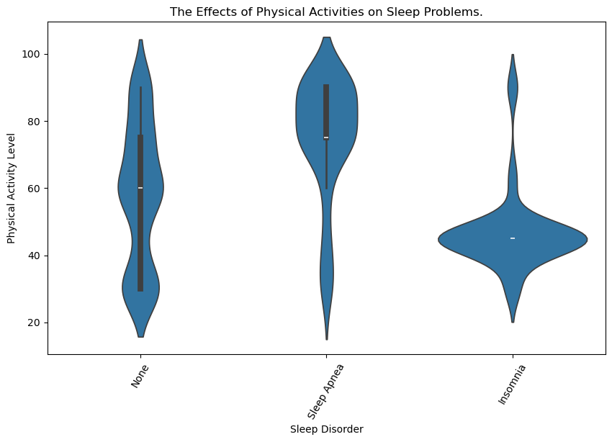
In individuals none group of sleep disorders, the distribution of physical activity is balanced.
In individuals with sleep disorders, in those with sleep apnea, the distribution of physical activity concentrates at high values, while in individuals with insomnia, the distribution of physical activity centralizes at low values.

Slide 13
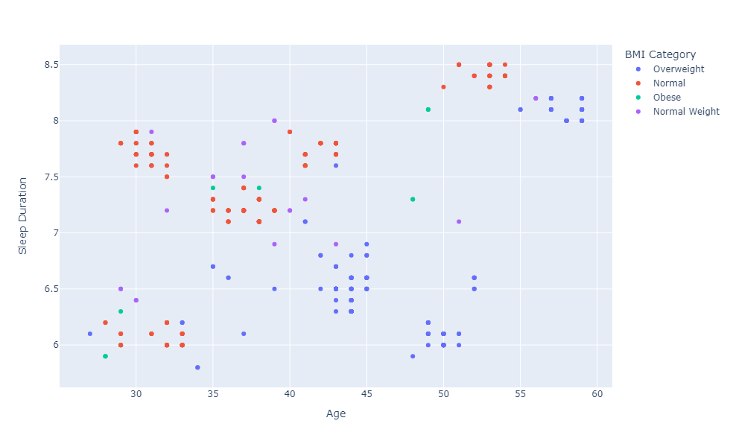
People aged 55-60 who sleep more than 8 hours are prone to being overweight.
People aged 35-55 who sleep less than 7 hours tend to be overweight.
People aged 50-55 who sleep more than 8 hours have a normal weight.
Most people under the age of 40 have a normal weight.

Slide 14
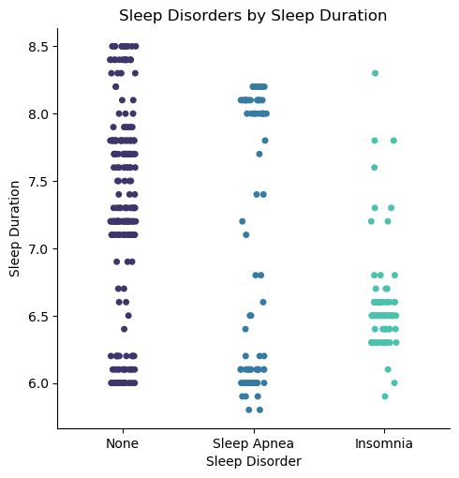
Insomnia: Individuals with insomnia have an average sleep duration of 6.5 hours.
No sleep disorder: Individuals with no sleep disorder have an average sleep duration of 7.5 hours.
Sleep apnea: Individuals with sleep apnea have an average sleep duration of 7 hours.
The data suggests that sleep disorder type can affect average sleep duration. Individuals with insomnia sleep the least compared to other sleep disorder types. Individuals with no sleep disorder have the longest average sleep duration. Individuals with sleep apnea sleep slightly longer than those with insomnia but slightly shorter than those with no sleep disorder.

Slide 15
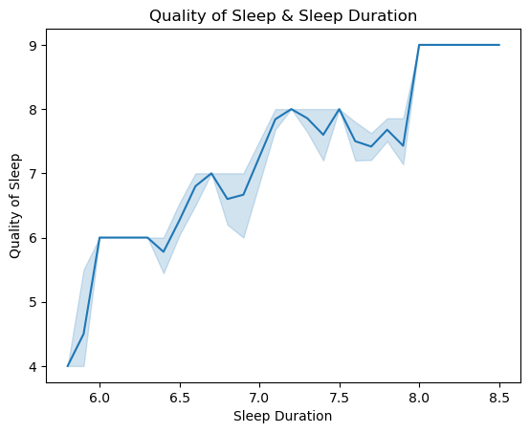
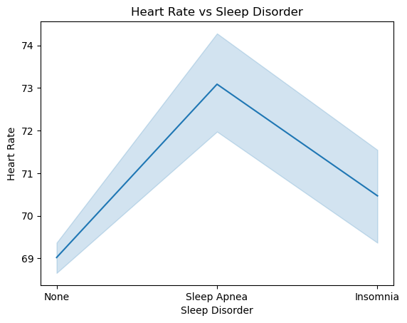
* There is a general positive correlation between sleep duration and sleep quality. In other words, as sleep duration increases, so does sleep quality.
* However, this relationship is not linear. Sleep quality increases to a certain point as sleep duration increases, and then begins to decrease. This indicates that the recommended ideal sleep duration for adults is around 7-8 hours. Sleeping less or more can negatively impact sleep quality.
As observed, the heart rate of individuals with sleep disorders is higher than those without sleep disorders. This indicates that sleep disorders can create stress on the heart and lead to an increase in heart rate.
Sleep apnea is a sleep disorder in which breathing temporarily stops. During sleep apnea, heart rate rises and falls, which can put stress on the heart.

Slide 16
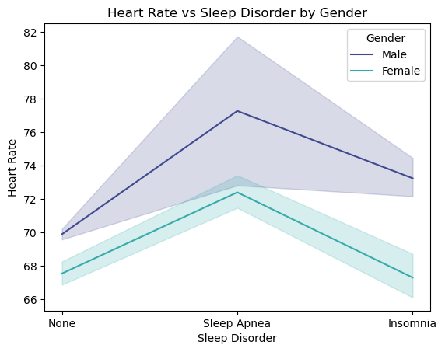
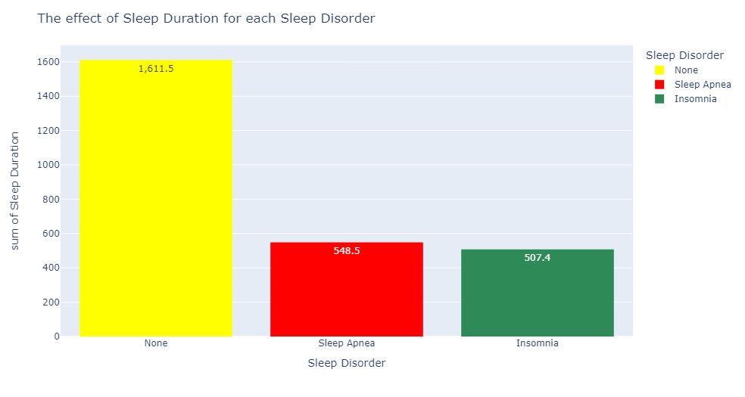
The total sleep duration in individuals with sleep apnea and insomnia is below 550 minutes, while in individuals with none sleep disorders, the total of these durations is 1611 minutes.
Based on the data, it's observed that men generally have a higher heart rate compared to women.

Slide 17
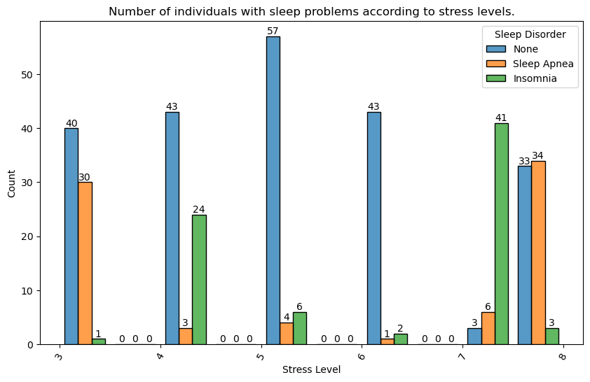
As the stress level increases, the numbers of individuals in the insomnia and sleep apnea groups also increase.
We cannot make a direct cause-and-effect interpretation because at a low level of stress (Level 3 stress), the number of individuals in the sleep apnea group is in the second position, while at Level 4 stress, insomnia is in the second position and close to the number of individuals in the none group. As the level increases, there is no linear correlation that we can establish. The data set may not be balanced in this regard.

Slide 18
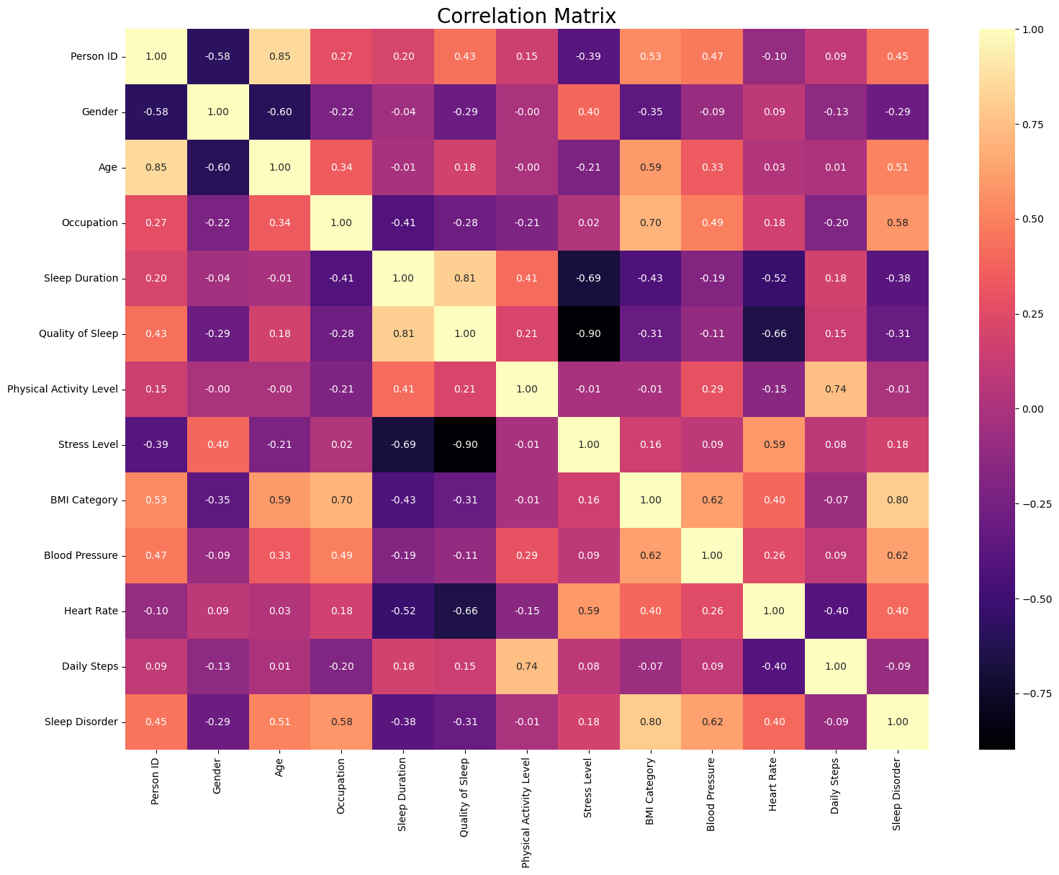

Slide 19
Model selection

Slide 20
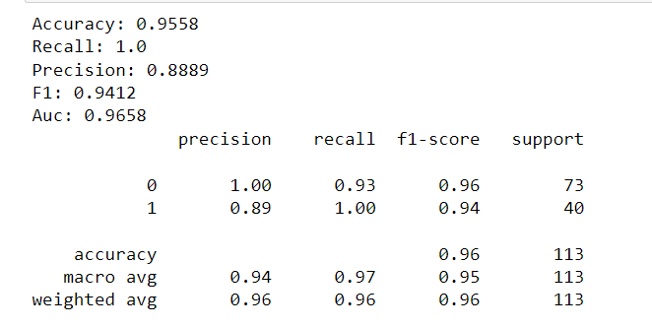
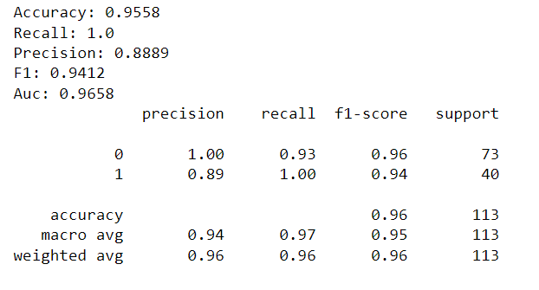
Random forest classifier

Slide 21
Power bi
Dasboard

Slide 22
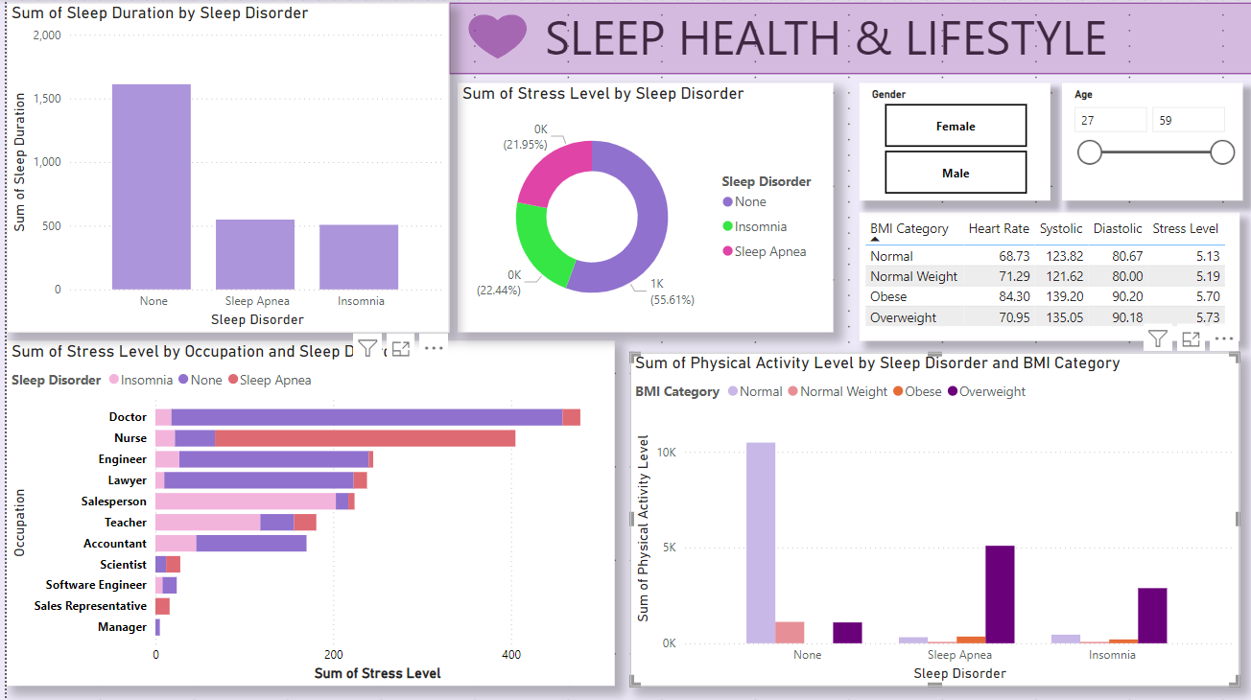

Slide 23
Thank you

